Slide 1

SAP Build Training for Corporate Professionals
DAY-12
www.anubhavtrainings.com

Slide 2


DISCLAIMER
The training content and delivery of this presentation is confidential, and cannot be recorded, or copied and distributed to any third party, without the written consent of Anubhav Trainings

Slide 3
Agenda
Invoice Process
Completing & Testing Scenario
Scenario
Invoice approval
PDF Extraction
PDF Extractions
Template
IRPA Document template

Slide 4

The Scenario – Invoice Approval
Sonia is working at Anubhav Trainings finance department; every we create and send invoices to the customer. Her job is to check the invoices, especially the amount and module name for each invoice and validate if the payment has been received in the bank account.
Currently she has to open every invoice manually and read the invoice amount, date and course name and validate the date & amount submitted by internal sales team.
She want us to automate this process where the sales team share the invoice details along with date and we need to send approval form only when date match with pdf invoice to Sonia. She reviews the details and provide invoice approval.
On approved an email will trigger to student that their payment has been received for the course.

Slide 5


















Flow

Slide 6
Understanding Excel SDK
The Excel SDK is a collection of activities allowing you to create automations using Microsoft Excel. It comes with a rich set of functionalities such as:
Create new Excel Workbook
Create new Excel Worksheet
Read and write data from an Excel sheet, for a given data range
Apply Filter on a column etc
To design your automation, you will need an Excel file filled with the sales orders data.
What is Excel Data Mapping?
Excel Data Mapping allows you to transform columns-based data from an Excel sheet into datatype that can be used in your automation. The data from the Excel sheet stays the same but the structure becomes a data type structure, making it possible to use throughout your project.

Slide 7

Scenario
Ran is working in the service department of the company; his routine job is to
read all the sales orders from an excel file he receives,
filter all the orders which are at urgent status
send an email to corresponding customer on order delivery date
In addition, filter orders with amount > 1000000 and create a new sheet in excel as Results
Keep the excel in his system

Slide 8
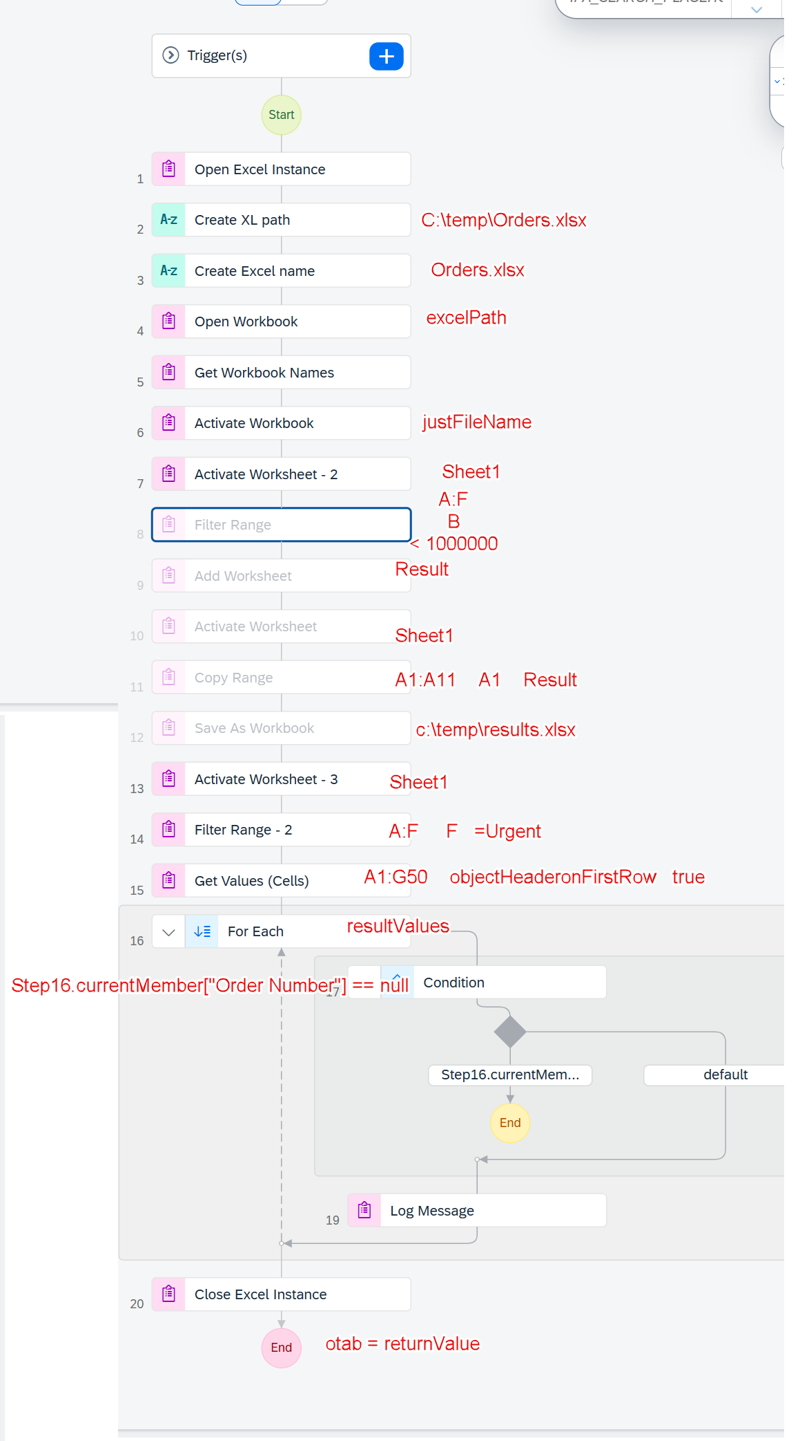

Automation Flow design by Anubhav

Slide 9

What We Did
Let’s Summarize
www.anubhavtrainings.com

Slide 10
www.anubhavtrainings.com
Thank You
End of Day 12
www.anubhavtrainings.com

Slide 11



We’re committed to empower you to be
#FutureReady
through powerful training solutions.
We build the workforce of the future.
250+
Corporate Clients
30,000+
Learners Trained
25000+
Learners Placed
FREE WEBINARS
Sign up for free webinars with industry experts every fortnight!
Enroll Now!
Contact us today!
https://anubhavtrainings.com

